Slide 1

PPA Design Space Explorer
Automated PPA Analysis for Digital VLSI Design Using Bash & TCL Scripting
EC2062 : Term Project / Lab Based Project Seminar Presentation
2nd Semester, Masters of Technology in Microelectronics and VLSI
Md. Irfan | Roll No. 25EC4211
Under the supervision of
Dr. Sapana Ranwa, Assistant Professor, Dept. of ECE
Department of Electronics and Communication Engineering
राष्ट्रीय प्रौद्योगिकी संस्थान दुर्गापुर
National Institute of Technology Durgapur
Mahatma Gandhi Avenue, Durgapur-713209, West Bengal, INDIA

Slide 2
Table of Contents
01
PPA Basics, Standard Cell & RVT Library
02
Why Automation is Needed in PPA Analysis
03
Complete Tool Flow and Working of the Explorer
04
How Bash & TCL Works Internally
05
Fast-Fast Corner for Maximum Speed
06
Typical-Typical Corner for Best Area
07
Slow-Slow Corner for Best Power + Clock Gating
08
Final Summary Report
09
Conclusion
10
Limitations & Future Scope
11
References

Slide 3
PPA Basics, Standard Cell & RVT Library
What is PPA?
Power - Dynamic + Leakage power in mW
Performance - Operating frequency / clock period
Area - Silicon footprint in µm²
PPA Analysis: To find the most suitable operating point for a given design
Over-constrain - wastes area & power
Under-constrain - design could run faster than you think
Standard Cell Library Used:
Library
SAED 14nm RVT
.db Files Used:
Process
14 nm
saed14rvt_base_ff0p88v25c.db ← Fast-Fast
saed14rvt_base_tt0p8v25c.db ← Typical-Typical
saed14rvt_base_ss0p72v125c.db ← Slow-Slow
saed14rvt_cg_ss0p72v125c.db ← Clock Gating
Variant
RVT (Regular Threshold Voltage)
Why RVT?
Balanced speed, area & power
Format
Liberty .db files

Slide 4
Why Automation is Needed in PPA Analysis
Traditional Approach
Automated PPA Explorer
Engineer guesses a clock period value
Manually edits TCL + SDC constraints
Runs synthesis - waits 10–30 min
Reads timing/area/power report manually
Adjusts period and reruns from scratch
Repeats for each corner separately
No systematic comparison of corners
Results vary - prone to human error
User gives: one .v file + top module name
Script auto-generates TCL for every run
Runs all 3 corners automatically
Parses all reports (WNS, area, power)
Adaptive steps
Generates structured FINAL_SUMMARY.rpt
Works for any single clock design
VS
→

Slide 5
Complete Tool Flow and Working of the Explorer
INPUT
FF
TT
SS
REPORT
Verilog RTL file
Top module name
Target slack
Clock constraints
Max Speed sweep
Adaptive Jump (Vary)
Forward sweep(1ns)
Trackback (-0.1ns)
Best tradeoff
Area sweep
Power sweep
+ Clock Gating
FINAL_SUMMARY.rpt
Best Speed/Area/
Power + CG%
›
›
›
›
Each synthesis run produces:
timing_setup.rpt - WNS (Worst Negative Slack)
timing_hold.rpt - WHS (Worst Hold Slack)
area.rpt - Total area in μm²
power.rpt - Total power in mW
netlist.v + .sdc - Synthesised output for PnR

Slide 6
How Bash & TCL Works Internally
TCL Script (auto-generated)
Generated fresh by Bash for every run
Sets library path: target_library + link_library
Defines clock constraints
Runs report_timing, report_area, report_power
Writes netlist.v and .sdc output files
Deleted after run
How Reports are Parsed:
# WNS from timing report
grep "slack (MET|VIOLATED)" timing.rpt | tail -1 | awk '{print $NF}'
# Total area
grep "Total area:" area.rpt | awk '{print $NF}'
# Total power (top-level 100.0% row)
awk '/100\.0/{print $(NF-1)}' power.rpt
Bash Script (master controller)
Environment Setup
Invoke Synopsys DC
Loops across corners
Parses reports using grep and awk
Uses extracted values to decide next step

Slide 7
Fast-Fast Corner for Maximum Speed
Sweep Algorithm Steps
Terminal Output
Probe at 1ns
First run. Reads WNS immediately from timing report.
1
CORNER: fast_fast | Target: 0.1ns
period=1.0ns WNS=-9.4 Area=52310 Power=12.1
Adaptive jump to 10.0ns
Smart Jump
If WNS < −1ns: next = current + ceil(|WNS|).
Skips useless iterations
period=10.0ns WNS=-0.08 Area=48200 Power=10.8
2
period=11.0ns WNS= 0.07 Area=48200 Power=10.8
period=12.0ns WNS= 0.15 Area=46800 Power=10.1
+1ns Steps
Steps forward +1ns each run until WNS ≥ TARGET_SLACK (0.1ns).
*** TIMING MET at 12.0ns ***
3
[FF TRACKBACK] stepping back 0.1ns...
11.9ns WNS=0.13
FF Trackback
11.8ns WNS=0.12
4
After timing met, step back −0.1ns each time.
Stops when WNS drops below 0.1ns. Last passing = best.
11.7ns WNS=0.11 <- best
11.6ns WNS=0.08 <- violated
[FF] Final best period: 11.7ns

Slide 8
Typical-Typical Corner for Best Area
Sweep Algorithm Steps
Terminal Output
Starts from where timing met for FF
Try to meet timing first
1
CORNER: typical_typical | Goal: area
period=12.0ns WNS=0.11 Area=44200 <- timing met
+1ns Steps
period=13.0ns WNS=1.2 Area=41500 (change 6.1%)
2
After timing met, sweep continues +1ns steps
period=14.0ns WNS=2.4 Area=39800 (change 4.1%)
period=15.0ns WNS=3.6 Area=39000 (change 2.01%)
period=16.0ns WNS=4.8 Area=38700 (change 0.77%)
*** AREA CONVERGED at 16.0ns — stopping ***
2% Convergence Rule
If area change < 2% then stop
3
4

Slide 9
Slow-Slow Corner for Best Power + Clock Gating
Sweep Algorithm Steps
Terminal Output
Starts from where timing met for TT
Try to meet timing first
CORNER: slow_slow | Goal: power
1
period=12.0ns WNS=-2.1 Power=9.8mW
period=13.0ns WNS=-0.8 Power=9.1mW
+1ns Steps
period=14.0ns WNS= 0.2 Power=8.5mW <- timing met
2
After timing met, sweep continues
period=15.0ns WNS= 1.4 Power=8.1mW (change 4.7%)
period=16.0ns WNS= 2.6 Power=7.9mW (change 2.5%)
period=17.0ns WNS= 3.8 Power=7.8mW (change 1.3%)
2% Convergence Rule
If power change < 2% then stop
*** POWER SWEEP DONE - best at 17.0ns ***
3
[CG RUN] Clock gating at 17.0ns...
[CG] Power=6.9mW Area=54200um2
Clock Gating Run
Clock gating cells are automatically inserted by DC, no RTL changes required.
4
Power without CG
Power with CG
CG Power Saving
7.8 mW
6.9 mW
11.5%

Slide 10
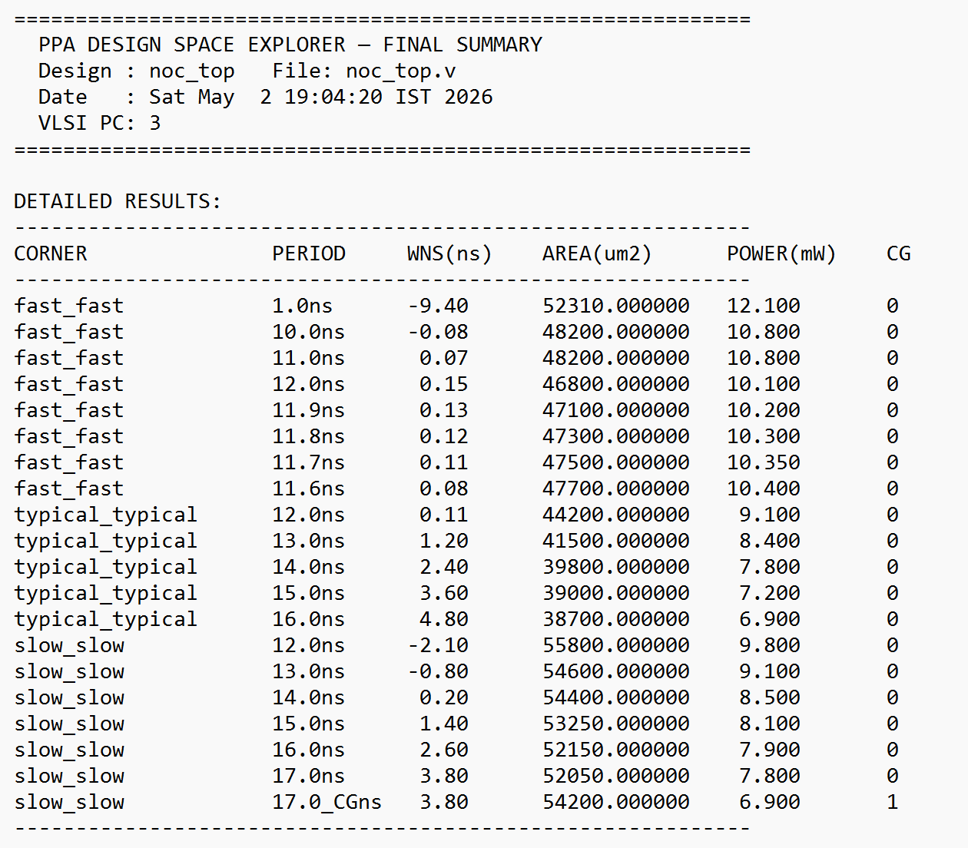
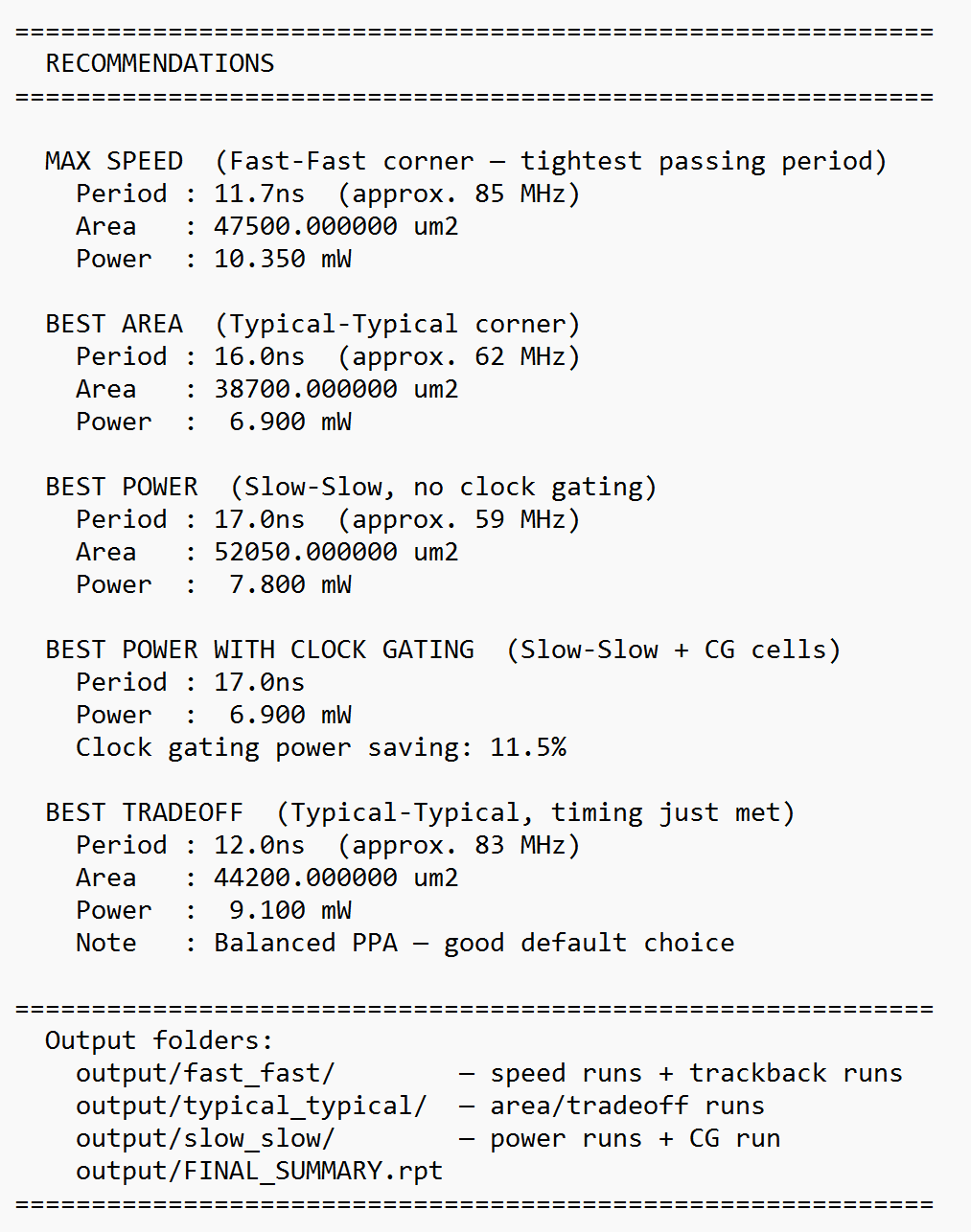
Final Summary Report (FINAL_SUMMARY.rpt)

Slide 11
Conclusion
01
Built a fully automated PPA exploration tool using Bash & TCL scripting
02
Sweeps three SAED 14nm RVT PVT corners (FF, TT, SS), without any manual intervention
03
Smart ceil-jump avoids wasted DC runs, 0.1 ns trackback finds the tightest passing period
04
TT area-convergence sweep identifies the true minimum-area configuration
05
SS power sweep + automatic clock gating synthesis reduces power
06
Single structured FINAL_SUMMARY.rpt gives clear recommendations for all four PPA goals

Slide 12
Limitations & Future Scope
01
Multi-clock support with separate SDC per clock
02
Additional Vt variants: HVT for ultra-low power
03
Hold violation checking added to sweep logic
04
Extend optimization to include post PnR reports for more accurate results

Slide 13
References
01
SAED 14nm EDK Digital Standard Cell Libraries Databook, Rev. 2.0.0, 2024.
02
Design Compiler User Guide - RTL Synthesis. Version T-2022.03.
03
Design Compiler TCL Command Reference Manual.
04
Bash Reference Manual - GNU Bash 5.1. [https://www.gnu.org/software/bash/manual/]
05
Tcl/Tk 8.6 Documentation. [https://www.tcl.tk/man/tcl8.6/]

Slide 14
Thank You for Your Attention!
PG SEMINAR PRESENTATION 2026
Any Questions?
Department of Electronics and Communication Engineering
राष्ट्रीय प्रौद्योगिकी संस्थान दुर्गापुर
National Institute of Technology Durgapur
Mahatma Gandhi Avenue, Durgapur-713209, West Bengal, INDIA

